Slide 1
NIVEDHA V
Final Project
3/21/2024 Annual Review

Slide 2
PREDECTING CUSTOMER CHURN IN TELECOMMUNICATION INDUSTRY USING RANDOM FOREST
PROJECT TITLE :
3/21/2024 Annual Review

Slide 3


AGENDA
Problem statement
Overview
Data Collection and Preprocessing
Solution and Value Proposition of Predicting Churn
Predictive Modeling with Random Forest
Model Training and Evaluation
Results
3/21/2024 Annual Review

Slide 4

PROBLEM STATEMENT
The telecommunications industry faces a persistent challenge in customer retention due to the phenomenon of churn, where customers switch to competitors or terminate services. Identifying factors contributing to churn and accurately predicting which customers are at risk is crucial for implementing targeted retention strategies and maintaining business sustainability.
3/21/2024 Annual Review

Slide 5

PROJECT OVERVIEW
The aim of this project is to develop a predictive model using Random Forest algorithm to forecast customer churn in the telecommunication industry with high accuracy and reliability. By analyzing historical customer data encompassing usage patterns, service interactions, demographics, and contract details, the model will predict the likelihood of individual customers churning within a specified future time period.
3/21/2024 Annual Review

Slide 6

WHO ARE THE END USERS?
Telecommunication Companies: Telecom companies are the primary end users of this project. They can leverage the predictive model to anticipate which customers are likely to churn, enabling them to take proactive measures to retain those customers. By identifying churn factors early on, telecom companies can develop targeted retention strategies, such as personalized offers or improved customer service.
Marketing and Sales Teams: Marketing and sales teams can utilize the insights from the churn prediction model to tailor their strategies for different customer segments. They can focus their efforts on retaining high-value customers who are at risk of churning, thereby optimizing marketing spend and increasing customer lifetime value.
3/21/2024 Annual Review

Slide 7
3. Customer Service Departments: Customer service departments can benefit from the churn prediction model by identifying dissatisfied customers in real-time and addressing their concerns promptly. By improving customer satisfaction and resolving issues efficiently, telecom companies can reduce churn rates and enhance overall customer experience.
4. Product Development Teams: Insights from the churn prediction model can guide product development teams in designing new services or enhancing existing ones to better meet customer needs and preferences. Understanding the factors contributing to churn can inform product improvements aimed at increasing customer satisfaction and loyalty.
5. Finance and Accounting Departments: Finance and accounting departments can use churn prediction results to forecast revenue losses associated with customer churn and assess the financial impact on the company.

Slide 8

SOLUTION ITS VALUE PROPOSITION
SOLUTION :
The solution for predicting Churn in telecommunication industry was implemented by training the dataset using Random Forest Algorithm as it offers a powerful and versatile approach to churn prediction in the telecommunications industry, leveraging its ability to handle high-dimensional data, capture nonlinear relationships, and provide interpretable insights into the factors driving churn, thereby helping telecom companies reduce customer attrition and enhance customer satisfaction and loyalty by generative model
3/21/2024 Annual Review

Slide 9
VALUE PROPOSITION
The value proposition of using Random Forest for churn prediction in the telecommunications industry are :
Accuracy: Random Forest typically yields high prediction accuracy due to its ensemble nature, which combines multiple decision trees.
Automation and Efficiency: By automating the churn prediction process with Random Forest, telecom companies can streamline their customer retention efforts and optimize resource allocation.
Robustness: Random Forest is robust to noise, outliers, and overfitting, making it suitable for real-world datasets with diverse characteristics. Its ability to handle high-dimensional data and correlated features ensures reliable churn predictions even in the presence of data imperfections.
Continuous Improvement: Random Forest facilitates continuous improvement through model retraining and iteration. Telecom companies can periodically update the model with new data to capture evolving churn patterns and customer behaviors, ensuring the model remains relevant and effective over time.

Slide 10

THE WOW IN YOUR SOLUTION
Using generative AI for predictive analytics can identify which customers are at risk of churning. By using real-time data related to behaviors, engagement, patterns, and trends, the algorithm can predict which customers are most at risk
Random forest provides the muscle for churn prediction, but the "wow factor" is the creative ways that we use its insights to personalize your approach and proactively address customer concerns.
It delivers better generalizability, avoids overfitting, and provides valuable insights into churn drivers.
This enhances robustness and improves performance when dealing with incomplete or noisy data.
10
3/21/2024 Annual Review

Slide 11
MODELLING:
Data Preparation:
Load the dataset containing features and labels (churn or not churn) using pandas.
Train-Test Split:
Split the dataset into training and testing sets (80% train, 20% test) using train_test_split from scikit-learn.
Model Training:
Initialize a Random Forest classifier (RandomForestClassifier) with 100 trees and train it on the training data.
Prediction:
Make predictions on the test set using the trained LLM model.
Evaluation:
Calculate the accuracy of the model on the test set using accuracy_score.
Generate a classification report containing precision, recall, and F1-score using classification_report.
Print the confusion matrix using confusion_matrix to visualize the model's performance.
3/21/2024 Annual Review
11

Slide 12
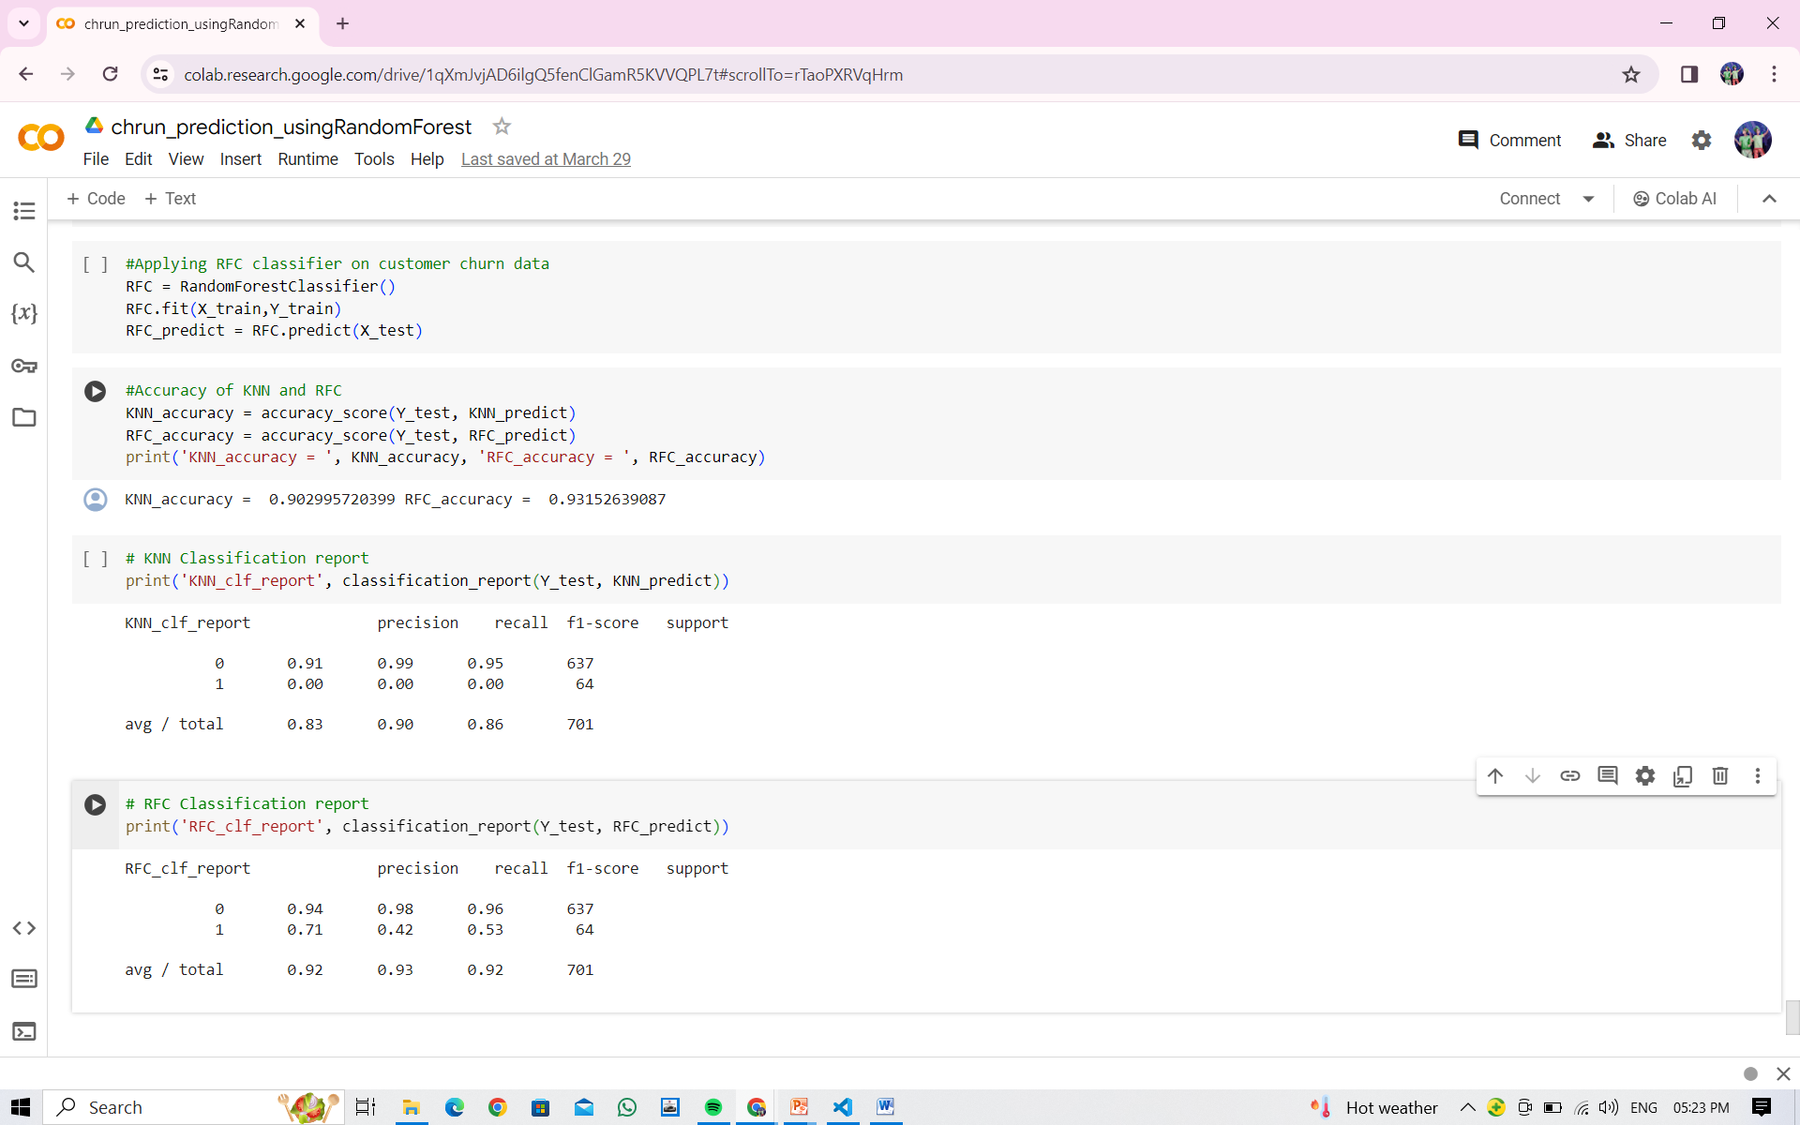
RESULTS
Demo Link
3/21/2024 Annual Review
12

